Slide 1
shape poker
Thomas Kagan

Slide 2
goal
Create an AI to self-learn through play

Slide 3
goal
Minecraft?

Slide 4
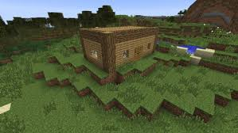
goal
Minecraft?

Slide 5
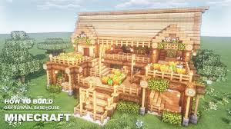
goal
Minecraft?

Slide 6
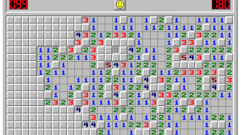
goal
Minecraft?
Minesweeper?

Slide 7
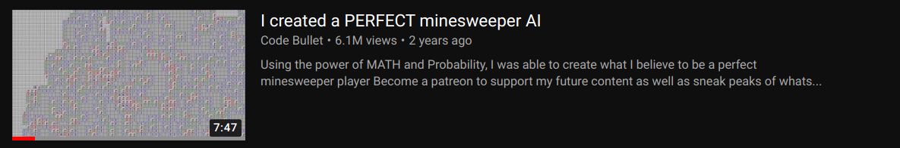
goal
Minecraft?
Minesweeper?
https://www.youtube.com/watch?v=cGUHehFGqBc

Slide 8
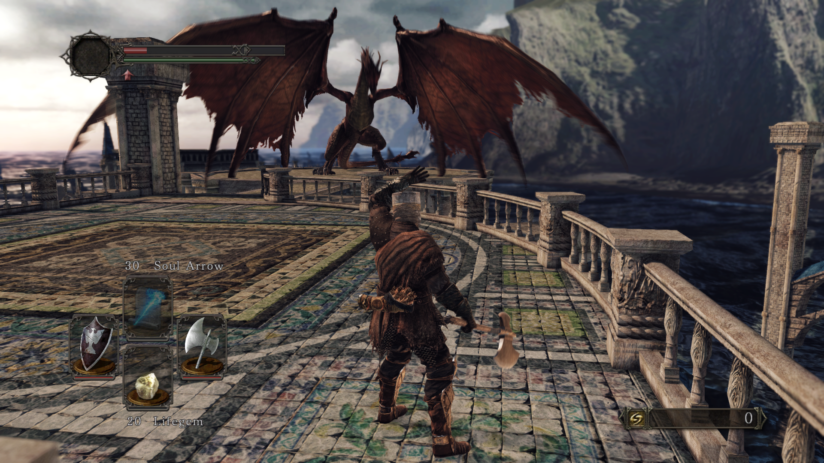
goal
Minecraft?
Minesweeper?
Dark Souls II?

Slide 9
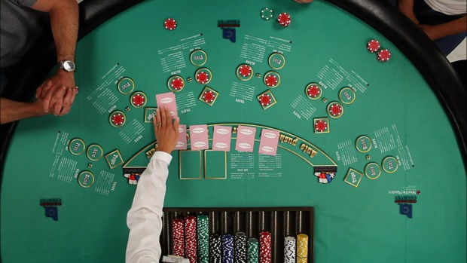
goal
Zero sum
Imperfect information
Easy to score
Zero sum
Imperfect information
Easy to score
Zero sum
Imperfect information
Easy to score

Slide 10
goal
Zero sum
Imperfect information
Easy to score
Zero sum
Imperfect information
Easy to score
Zero sum
Imperfect information
Easy to score
Computationally large

Slide 11
goal
Create an AI to self-learn through playing Shape Poker

Slide 12
goal
Create an AI to self-learn through playing Shape Poker
  Study local minimums and how to avoid them
  Study computational feasibility of stochastic methods

Slide 13
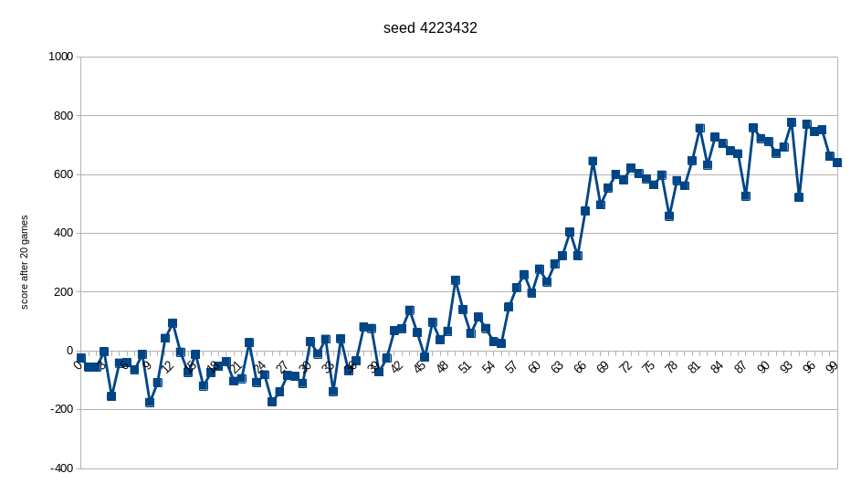
success!

Slide 14
project
The game
The player
The learning algorithm

Slide 15
project
The game – components, rules, simulation
The player
The learning algorithm

Slide 16
project
The game – components, rules, simulation
The player – perception, decision making
The learning algorithm

Slide 17
project
The game – components, rules, simulation
The player – perception, decision making
The learning algorithm – feedback, learning

Slide 18
project
The game – components, rules, simulation
The player – perception, decision making
The learning algorithm – feedback, learning
*My contributions

Slide 19
project
The game – components, rules, simulation
The player – perception, decision making
The learning algorithm – feedback, learning

Slide 20
game
seed 1512398
round 1 ( P2 has earned 0 )
deal, pot is 2
R: [triangle(red), circle(green)]
P1: [triangle(green), diamond(lavender)] ( 0 )
P2: [circle(green), square(blue)] ( 0 )
P1 raises 2
P2 raises 1
P1 calls
flop, pot is 10
R: [triangle(red), circle(green), square(blue)]
P1: [triangle(green), diamond(lavender)] ( 4 )
P2: [circle(green), square(blue)] ( 1 )
P1 folds
P2 wins!
round 2 ( P2 has earned +6 )
deal, pot is 2
R: [triangle(lavender), circle(blue)]
. . .

Slide 21
game
seed
6734345
playing 10000 rounds
0.49328194979689616
seed
9756767
playing 10000 rounds
0.6509583818701684
seed
4223432
playing 10000 rounds
0.45613470613470614
seed
2498375
playing 10000 rounds
0.4293637505232315
. . .
Either player is equally likely to win
P1 Win %

Slide 22
game
seed
6734345
playing 10000 rounds
0.49328194979689616
seed
9756767
playing 10000 rounds
0.6509583818701684
seed
4223432
playing 10000 rounds
0.45613470613470614
seed
2498375
playing 10000 rounds
0.4293637505232315
. . .
Either player equally likely to win, for
any two random players
Some players are objectively better than others

Slide 23
game
seed
1512398
playing 10000 rounds
[(0, 0.36931642437364676), (1, 0.3244664398391587), (2, 0.21517682235281987), (3, 0.06485204660274255), (4, 0.026188266831632126)]
seed
4963463
playing 10000 rounds
[(0, 0.252043112637688), (1, 0.34869122349875636), (2, 0.2618737415610565), (3, 0.09463460855146275), (4, 0.04275731375103636)]
seed
1283218
playing 10000 rounds
[(0, 0.3471475271538543), (1, 0.339238637561953), (2, 0.22113255298956028), (3, 0.06485289465359063), (4, 0.027628387641041863)]
seed
8374263
playing 10000 rounds
[(0, 0.2569620253164557), (1, 0.357307249712313), (2, 0.2518987341772152), (3, 0.09194476409666283), (4, 0.04188722669735328)]
seed
6712362
playing 10000 rounds
[(0, 0.28474988933156264), (1, 0.34462151394422313), (2, 0.24369189907038513), (3, 0.08919876051350155), (4, 0.037737937140327575)]
seed
4387523
playing 10000 rounds
[(0, 0.3286858807616273), (1, 0.34460513994381436), (2, 0.226303194256581), (3, 0.07137654770575383), (4, 0.029029237332223495)]
seed
6734345
. . .

Slide 24
game

Slide 25
game
4 of each kind of card in the deck

Slide 26
game
4 of each kind of card in the deck
Each player has 2 cards in their hand

Slide 27
game
4 of each kind of card in the deck
Each player has 2 cards in their hand
2-3 cards on table, “river”

Slide 28
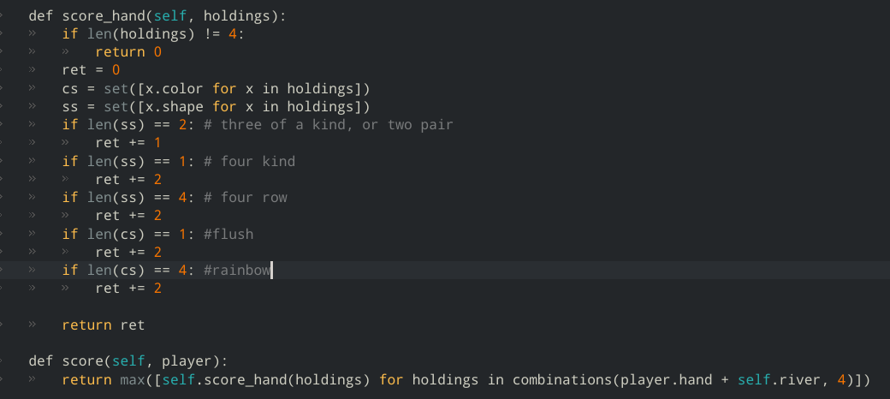
game

Slide 29
game
hand+river -1

Slide 30
game
1. Deck is shuffled

Slide 31
game
1. Deck is shuffled
2. Each player draws 2 cards, two cards are place face up in the river

Slide 32
game
1. Deck is shuffled
2. Each player draws 2 cards, two cards are place face up in the river
3. P1 makes a bet. P2 can match it, or fold, or raise. P1 has to match a raise, or fold

Slide 33
game
1. Deck is shuffled
2. Each player draws 2 cards, two cards are place face up in the river
3. P1 makes a bet. P2 can match it, or fold, or raise. P1 has to match a raise, or fold
4. A third card is drawn from the deck to add to the river. Called “The Flop”

Slide 34
game
1. Deck is shuffled
2. Each player draws 2 cards, two cards are place face up in the river
3. P1 makes a bet. P2 can match it, or fold, or raise. P1 has to match a raise, or fold
4. A third card is drawn from the deck to add to the river. Called “The Flop”
5. Another round of betting ensues, in the same order

Slide 35
game
1. Deck is shuffled
2. Each player draws 2 cards, two cards are place face up in the river
3. P1 makes a bet. P2 can match it, or fold, or raise. P1 has to match a raise, or fold
4. A third card is drawn from the deck to add to the river. Called “The Flop”
5. Another round of betting ensues, in the same order
6. Scores are tallied, the winner takes the pot

Slide 36
game
1. Deck is shuffled
2. Each player draws 2 cards, two cards are place face up in the river
3. P1 makes a bet. P2 can match it, or fold, or raise. P1 has to match a raise, or fold
4. A third card is drawn from the deck to add to the river. Called “The Flop”
5. Another round of betting ensues, in the same order
6. Scores are tallied, the winner takes the pot
7. If there’s a tie, the pot carries over to the next round
8. Go to 1

Slide 37
project
The game – components, rules, simulation ✔️
The player – perception, decision making
The learning algorithm – feedback, learning

Slide 38
player
💪 “action weights”
🌳 “environment”
🧠 “strategy representations”
👀 “percept functions”
👀(🧠,🌳) = 💪

Slide 39
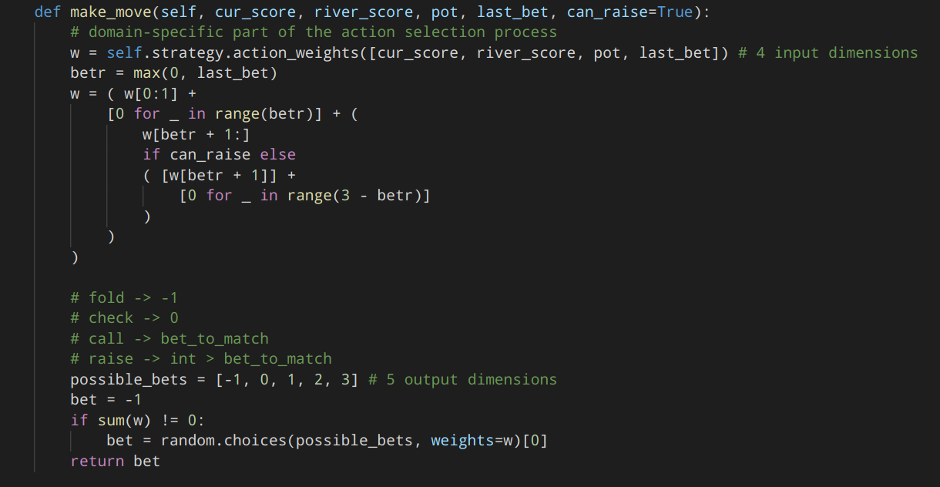
player
👀(🧠,🌳) = 💪
💪 “action weights”

Slide 40
player
👀(🧠,🌳) = 💪
💪 “action weights”

Slide 41
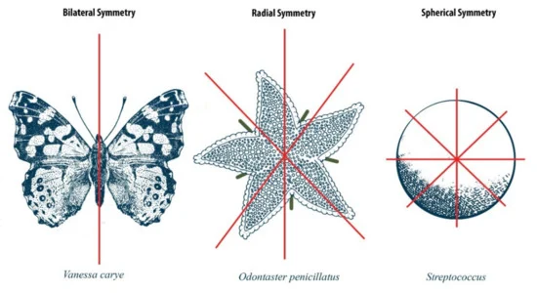
player
👀(🧠,🌳) = 💪
🌳 “environment”

Slide 42
player
👀(🧠,🌳) = 💪
🌳 “environment”

Slide 43
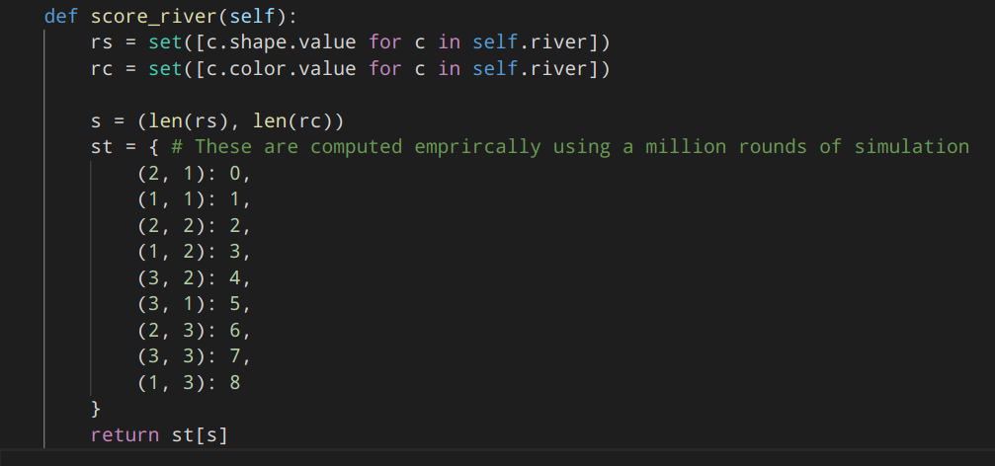
player
👀(🧠,🌳) = 💪
🌳 “environment”

Slide 44
player
👀(🧠,🌳) = 💪
🧠 “strategy representations”
[ ]
#
#
#
#
#
#
#
#
#
#
#
#
#
#
#
#
#
#
#
#
A Matrix

Slide 45
player
👀(🧠,🌳) = 💪
🧠 “strategy representations”
[ ]
A Matrix

Slide 46
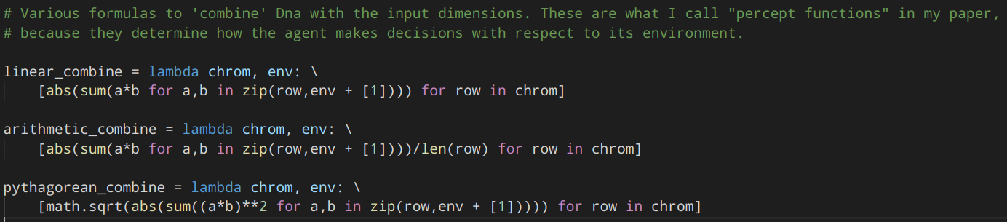
player
👀(🧠,🌳) = 💪
👀 “percept functions”

Slide 47
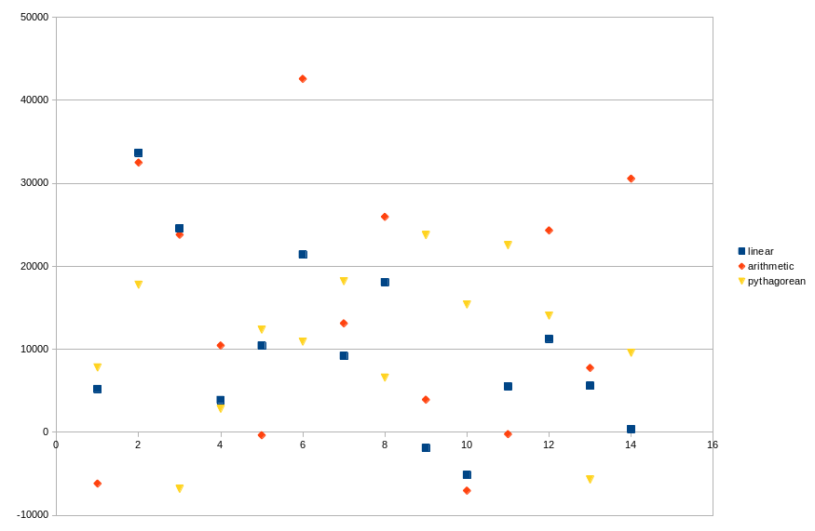
player
👀(🧠,🌳) = 💪
👀 “percept functions”
👀(🧠,🌳) = 💪

Slide 48
project
The game – components, rules, simulation ✔️
The player – perception, decision making ✔️
The learning algorithm – feedback, learning

Slide 49
learning algorithm
🧠 = 🧬

Slide 50
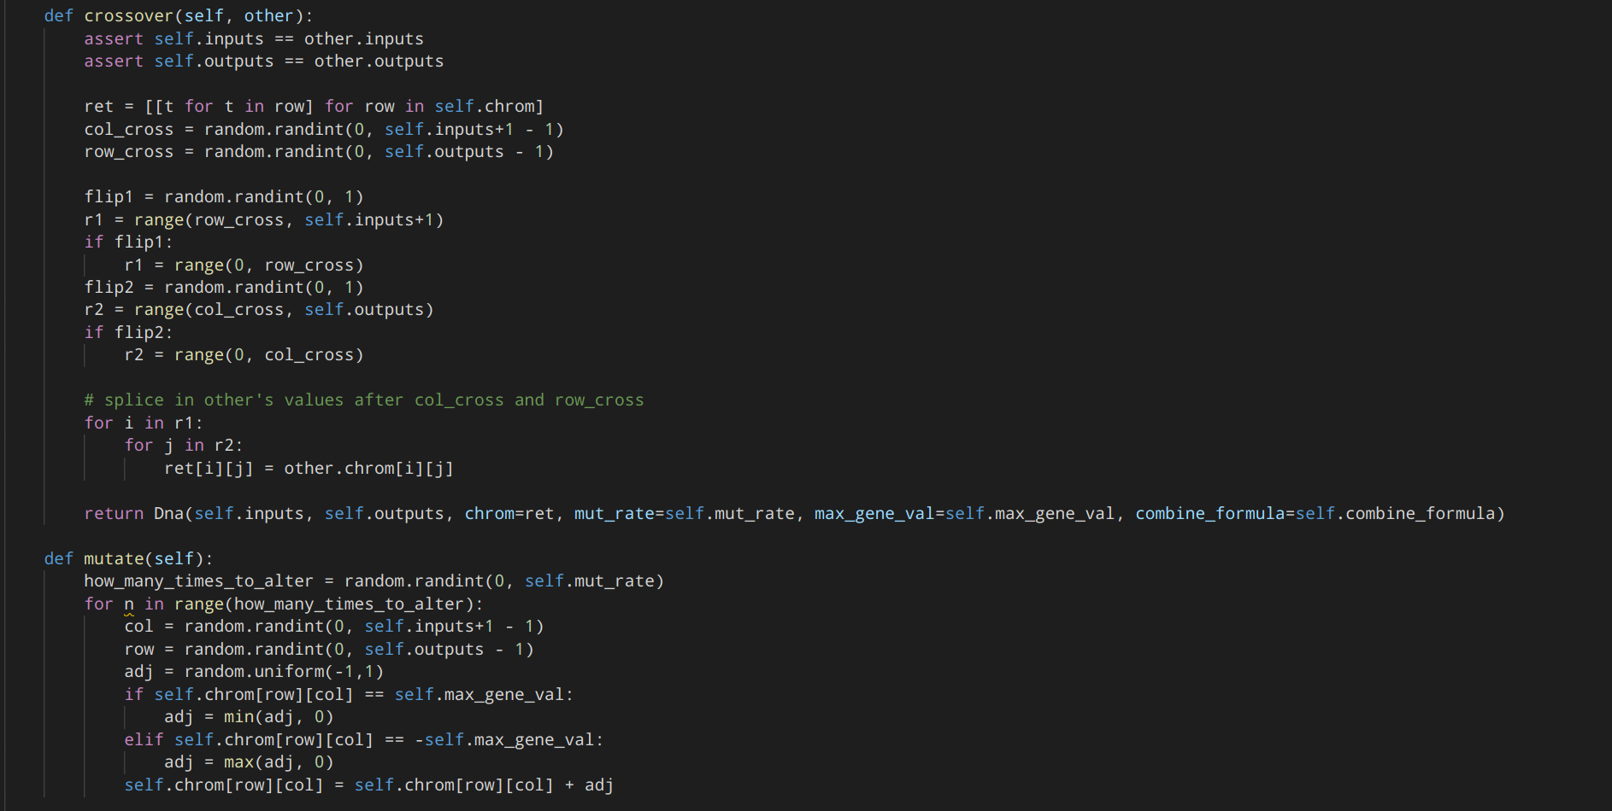
learning algorithm
🧠 = 🧬

Slide 51
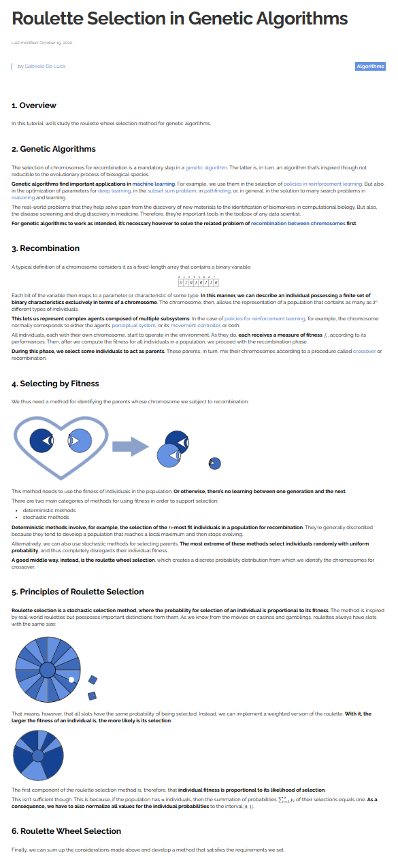
learning algorithm
https://www.baeldung.com/cs/genetic-algorithms-roulette-selection

Slide 52
learning algorithm
https://en.wikipedia.org/wiki/Genetic_algorithm#The_building_block_hypothesis

Slide 53
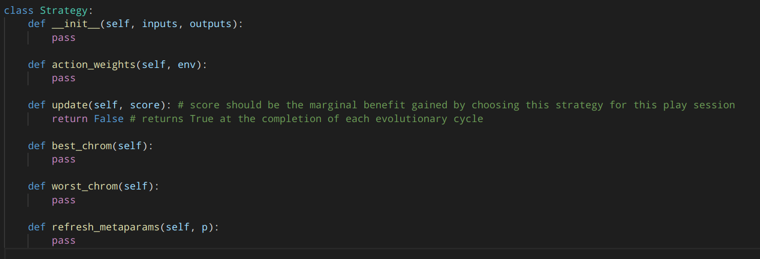
learning algorithm

Slide 54
project
The game – components, rules, simulation ✔️
The player – perception, decision making ✔️
The learning algorithm – feedback, learning ✔️

Slide 55
voila!
💸

Slide 56
🚀
Ways to improve more quickly
Ways to improve sooner
Ways to improve more
Ways to improve against another learning opponent
Document other search kinds (e.g. ant colony) and their effectiveness
A priori understanding of search, and theoretical optimality
The effectiveness of stochastic methods
Inverse problems and solution heuristics
Various ways to code a solution as DNA*
Various ways to assimilate experience, including 🔥attention-based🔥
Persisting knowledge gained across games
Realtime
Games that require logical consistency in addition to strategy
The elimination of blind, nonsensical behaviors; intuition or fuzzy reasoning
Games that require short-term vs long-term tradeoffs i.e. resource management
Applied parallel or hardware-accellerated computation in an effective way
Population/ecosystem dynamics

Slide 57
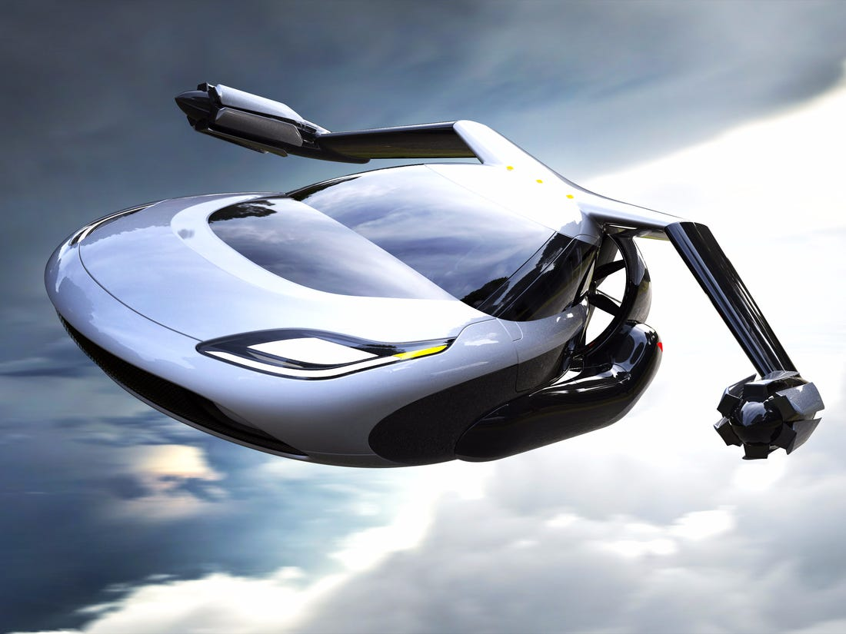
🚀

Slide 58
🚀
https://defensemaven.io/warriormaven/air/why-an-air-force-6th-gen-stealth-fighter-is-here-almost-10-years-early-Q9gApEljfk-3iXPKqvmH5Q

Slide 59
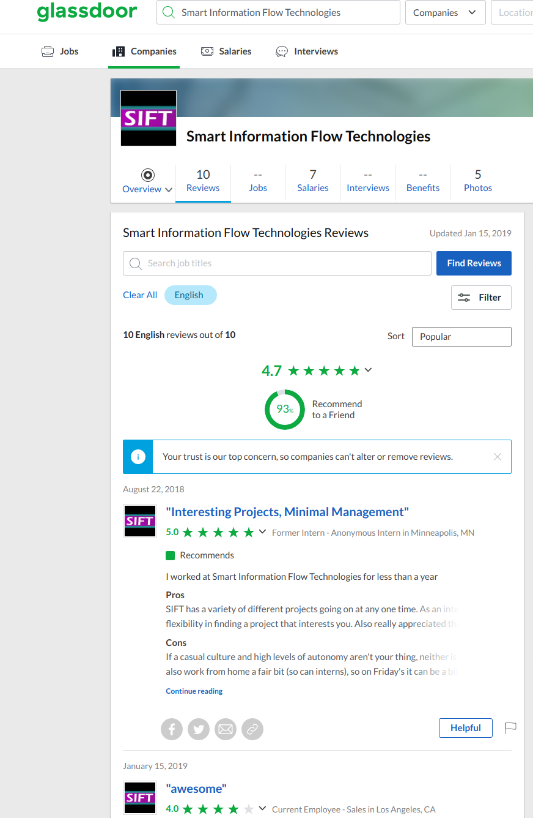
thanks!
Seems like an excellent
place to work.

